Slide 1
Greenway for
NW 15th Street
Presented by

Slide 2
Introductions
Lucas Freeman & Aron Yarmo, Bend Bikes - greenways@bendbikes.org
Sonya Bentley
Bike Bikes is non-profit committed to promoting Active Transportation. Our primary mission is to get more people riding bikes for fun and transportation.
Introductions around the room

Slide 3
What?
15th Street Greenway
Why?
15th Street has issues
City has identified 15th Street for Greenway implementation
How?
Active community involvement

Slide 4
Construction: 2019 (estimated)
Poster @ Bend Open Streets, September 2016

Slide 5
Whose Project is this Anyway?
This project, whatever it becomes, is going to hinge on neighbor involvement.
Bend Bikes to play a support role: help organize the project, drive communications, liaison with City staff.
Other players:
City of Bend staff
River West Neighborhood Association
Bend City Council

Slide 6
Define Overall Objectives
Question: What’s the objective on NW 15th?
Some ideas:
Slow down car speeds
Reduce number of non-neighborhood cars using street
Increase number of cyclists and walkers
Make it safer for all road users
Return NW 15th to a “residential” street
Notes:
Come up with an exercise to list out possible objectives; gather them up and suggest they vote on key project objectives. Use that voting as a way to recruit more neighbors into project and engage them.

Slide 7
Where and For How Long
What stretch of NW 15th should the project cover?
Galveston to Simpson??
How long should the project last??
30-day demonstration project?
Start with a shorter duration and then get neighborhood input on what to change/enhance and redeploy??

Slide 8
What’s Possible - Barriers vs Surface Treatments
Surface Treatments are roadway markings
Paint stripes
Roll outs/mats
Tape
Pros: quick and cheap to deploy
Cons: can be ignored by motorists

Slide 9
What’s Possible - Barriers vs Surface Treatments
Barriers separate car traffic from other road users
Flexi-posts
Planters
Parking stops
Pros: can be more permanent; more likely to change driver behavior Cons: cost more; requires logistics and more planning to install
More resources >> http://tacticalurbanismguide.com/

Slide 10
What’s Possible - Barrier Types
There are a variety of traffic calming measures that can be adopted. They vary in use and outcomes.
Chicanes
Mini-roundabout
Curb extensions (bulb outs)

Slide 11
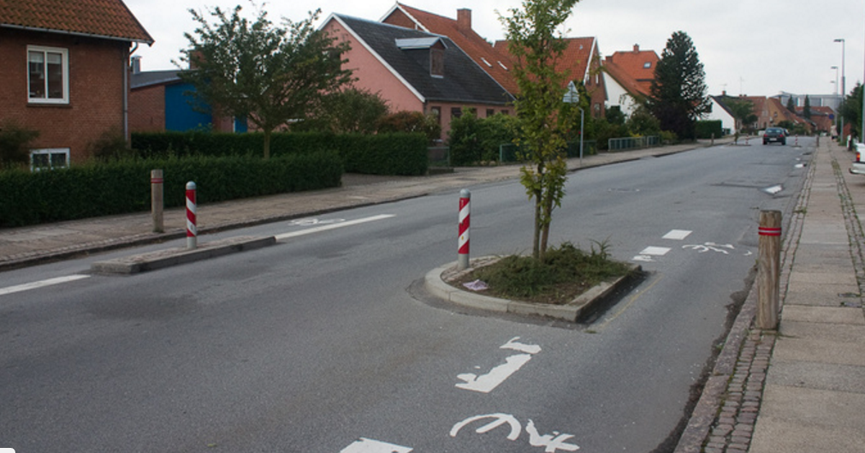
What’s Possible: Chicane

Slide 12
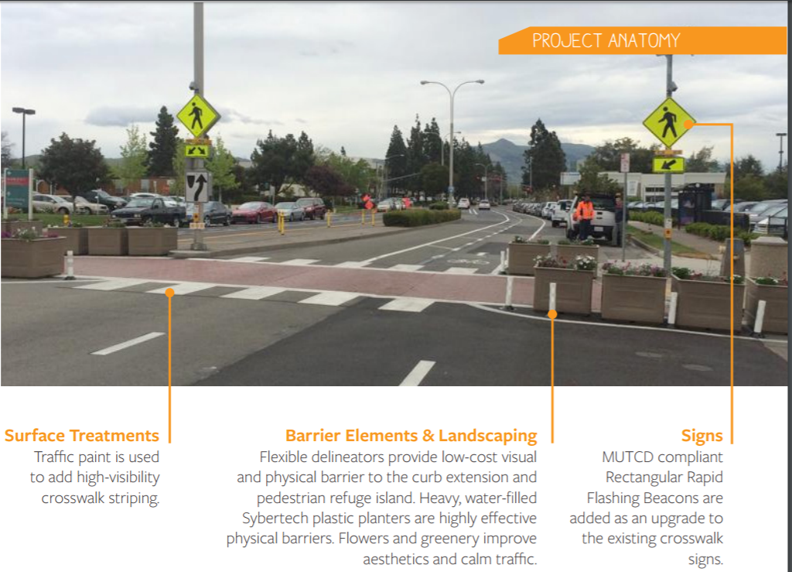
What’s Possible: Curb Extensions

Slide 13
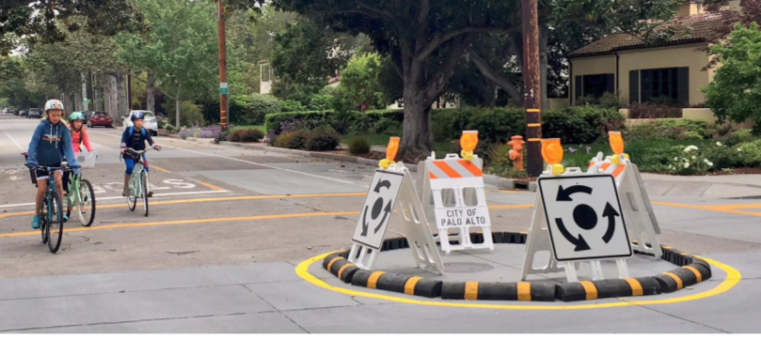
What’s Possible: Mini-Roundabout

Slide 14
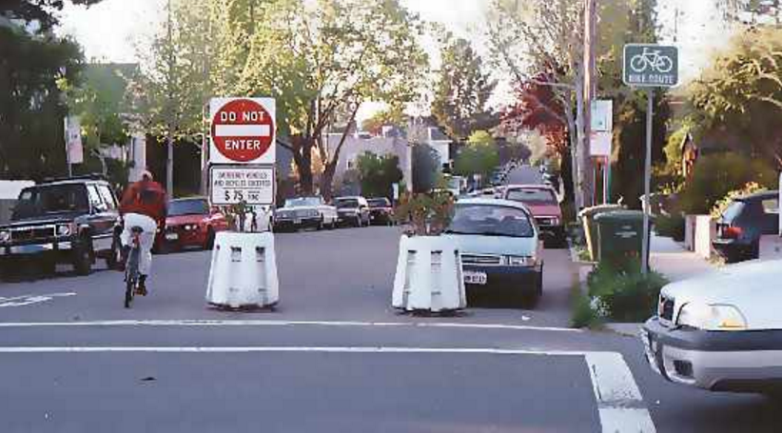
What’s Possible: Barriers

Slide 15
Map MarkUp Exercise
Split into groups to select where you’d like a traffic calming element

Slide 16
Communications
Options to consider
Electronic newsletter
Via ODNA
Website
Facebook page

Slide 17
Possible Next Steps
Decide: Project scope and objectives
Decide: Traffic calming preferences
Decide: Strategies for communications
Decide: Stakeholders to engage and at what point
Engage more neighbors and build support
Fundraise
Present to City Council
Implement

